Slide 1

AutoML Find and deploy the best models in minutes
https://developer.ibm.com/technologies/artificial-intelligence/series/explore-autoai/
Notes:
The objective of the support vector machine algorithm is to find a hyperplane in an N-dimensional space(N — the number of features) that distinctly classifies the data points.
objective is to find a plane that has the maximum margin
The basics of Support Vector Machines and how it works are best understood with a simple example. Let’s imagine we have two tags: red and blue, and our data has two features: x and y. We want a classifier that, given a pair of (x,y) coordinates, outputs if it’s either red or blue. We plot our already labeled training data on a plane:
A support vector machine takes these data points and outputs the hyperplane (which in two dimensions it’s simply a line) that best separates the tags. This line is the decision boundary: anything that falls to one side of it we will classify as blue, and anything that falls to the other as red.
Maximizing the margin distance provides some reinforcement so that future data points can be classified with more confidence.
Support Vector Machines (SVM) output an optimal line of separation between the classes, based on the training data entered as input. This line of separation is called a hyperplane in a multi-dimensional environment. SVM takes into consideration outliers that lie pretty close to another class to derive this separating hyperplane. After the model is constructed with this hyperplane, any new point to be predicted checks to see which side of the hyperplane this values lies in.

Slide 2

Why Automated Machine Learning?
High demand for data scientists & machine learning developers but no skills to meet the demand
Disadvantages of traditional machine learning techniques
Time Consuming
Requires lots of effort
Extensive knowledge of algorithms & domain knowledge
Notes:
Classification is a subcategory of supervised learning where the goal is to predict the categorical class labels (discrete, unoredered values, group membership) of new instances based on past observations.
Classification is the process of predicting the class of given data points.

Slide 3
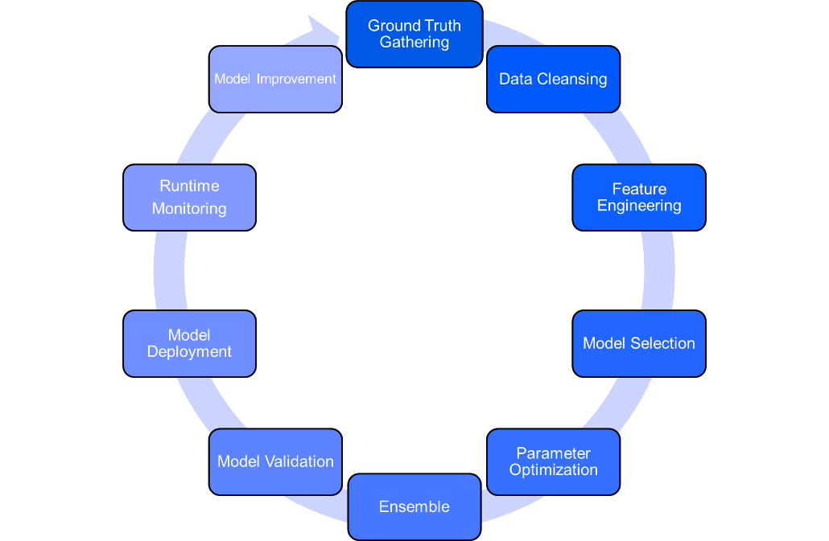
What are the benefits of Automated Machine Learning?
Coming up with features is difficult, time-consuming, requires expert knowledge. "Applied machine learning" is basically feature engineering.
-Andrew Ng
AI Lifecycle Management
Notes:
presence of a particular feature in a class is unrelated to the presence of any other feature or that all of these properties have independent contribution to the probability.
Naive Bayes algorithms are mostly used in sentiment analysis, spam filtering, recommendation systems etc. They are fast and easy to implement but their biggest disadvantage is that the requirement of predictors to be independent. In most of the real life cases, the predictors are dependent, this hinders the performance of the classifier.

Slide 4
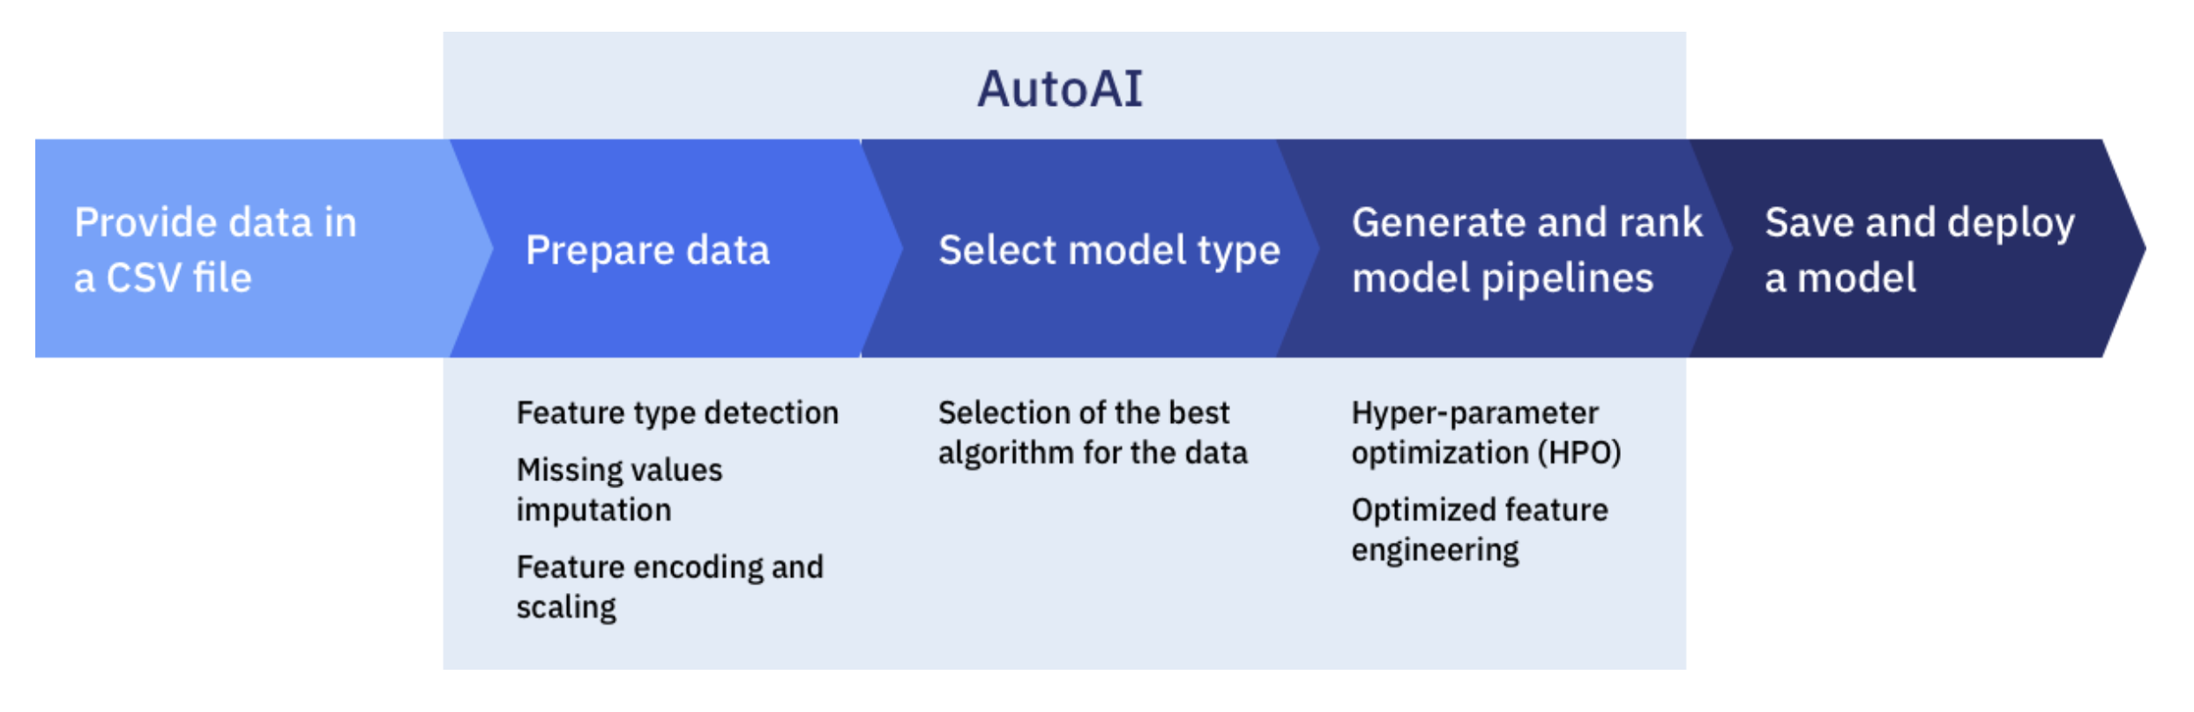
Introducing AutoAI
Notes:
The objective of the support vector machine algorithm is to find a hyperplane in an N-dimensional space(N — the number of features) that distinctly classifies the data points.
objective is to find a plane that has the maximum margin
The basics of Support Vector Machines and how it works are best understood with a simple example. Let’s imagine we have two tags: red and blue, and our data has two features: x and y. We want a classifier that, given a pair of (x,y) coordinates, outputs if it’s either red or blue. We plot our already labeled training data on a plane:
A support vector machine takes these data points and outputs the hyperplane (which in two dimensions it’s simply a line) that best separates the tags. This line is the decision boundary: anything that falls to one side of it we will classify as blue, and anything that falls to the other as red.
Maximizing the margin distance provides some reinforcement so that future data points can be classified with more confidence.
Support Vector Machines (SVM) output an optimal line of separation between the classes, based on the training data entered as input. This line of separation is called a hyperplane in a multi-dimensional environment. SVM takes into consideration outliers that lie pretty close to another class to derive this separating hyperplane. After the model is constructed with this hyperplane, any new point to be predicted checks to see which side of the hyperplane this values lies in.

Slide 5
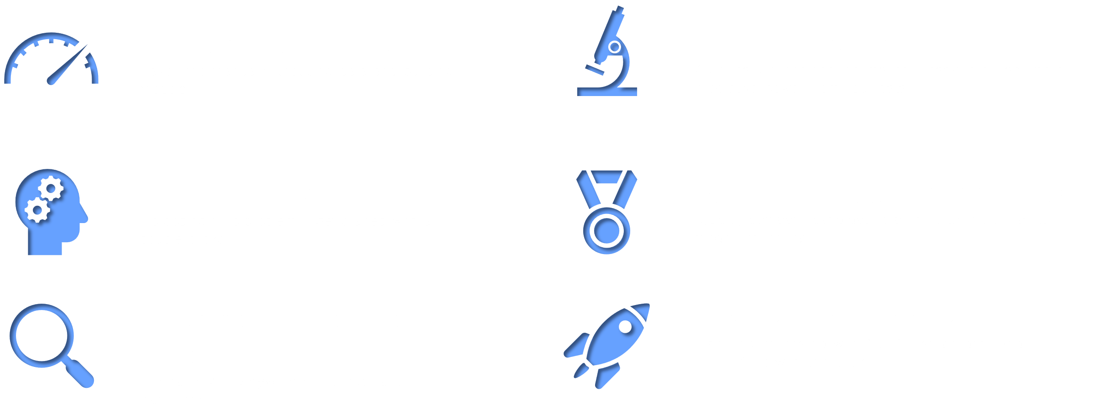
Benefits of using AutoAI
Get started at: https://ibm.biz/WebinarClassification
Learn classification algorithms using Python and scikit-learn / April 25, 2020 / © 2020 IBM Corporation
Notes:
The objective of the support vector machine algorithm is to find a hyperplane in an N-dimensional space(N — the number of features) that distinctly classifies the data points.
objective is to find a plane that has the maximum margin
The basics of Support Vector Machines and how it works are best understood with a simple example. Let’s imagine we have two tags: red and blue, and our data has two features: x and y. We want a classifier that, given a pair of (x,y) coordinates, outputs if it’s either red or blue. We plot our already labeled training data on a plane:
A support vector machine takes these data points and outputs the hyperplane (which in two dimensions it’s simply a line) that best separates the tags. This line is the decision boundary: anything that falls to one side of it we will classify as blue, and anything that falls to the other as red.
Maximizing the margin distance provides some reinforcement so that future data points can be classified with more confidence.
Support Vector Machines (SVM) output an optimal line of separation between the classes, based on the training data entered as input. This line of separation is called a hyperplane in a multi-dimensional environment. SVM takes into consideration outliers that lie pretty close to another class to derive this separating hyperplane. After the model is constructed with this hyperplane, any new point to be predicted checks to see which side of the hyperplane this values lies in.

Slide 6
Next Steps?
Use AutoML to find and deploy the best models in minutes
Compare model building with and without AutoML
AutoAI Overview
Notes:
Classification is a subcategory of supervised learning where the goal is to predict the categorical class labels (discrete, unoredered values, group membership) of new instances based on past observations.
Classification is the process of predicting the class of given data points.

